Slide 1
Predicted Gas Demand by County

Slide 2
Introduction
Notes:
Where to invest
Where to divest
Explore what is driving gasoline demand growth

Slide 3
Why Investigate
Determine where to invest
Determine where to divest
Explore what is driving gasoline demand growth

Slide 4
Central Question
What is the predicted demand for gasoline, by county, in $ (USD), in 2030?
Highest demand?
Lowest demand?

Slide 5
Data Wrangling
Notes:
Where to invest
Where to divest
Explore what is driving gasoline demand growth

Slide 6
Factors
2030 Projected Fuel Use Increase Percentage for US
2016 Fuel Use per Capita per County
Predicted 2030 Gas Price per State
Projected 2030 Population per County
Notes:
2030 Projected Fuel Use Increase Percentage for US

Slide 7
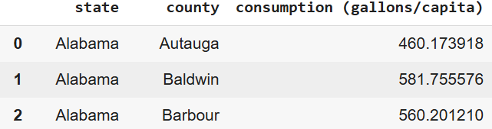
Consumption per Capita (2016)
Original dataset contained mountains of energy-related data by county.
The county column had to be changed to prepare it for later merging
Remove “County,” after county name
Remove state code in county name
Used US package for efficient wrangling

Slide 8
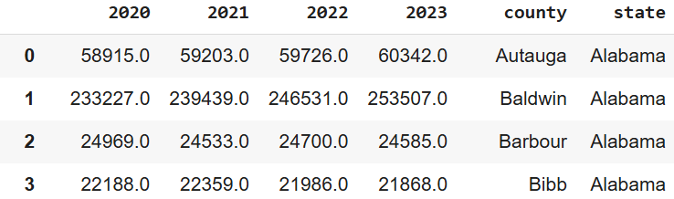
Historic County Population
Original dataset didn’t place all column titles on the same row, but didn’t need much pruning.
County name cleaned for later merging
Inverted table for analysis
Added “Number” column for time
Removed the “state” column

Slide 9
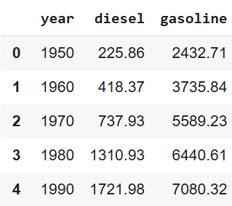
Fuel Use
Removed non-sequential early entries
Added “Numbers” column for years since 2000
Removed information on diesel usage

Slide 10
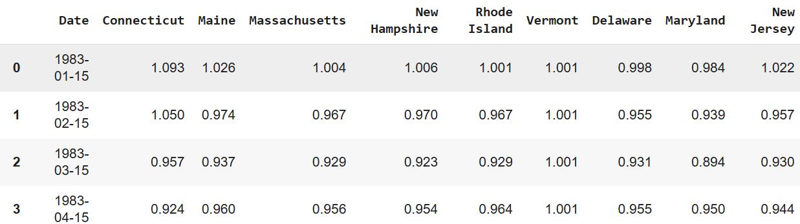
Gas Prices per State
Pruned original dataset
US package
Renamed columns for easy use
Interpolation

Slide 11
Data Analysis
Notes:
Where to invest
Where to divest
Explore what is driving gasoline demand growth

Slide 12
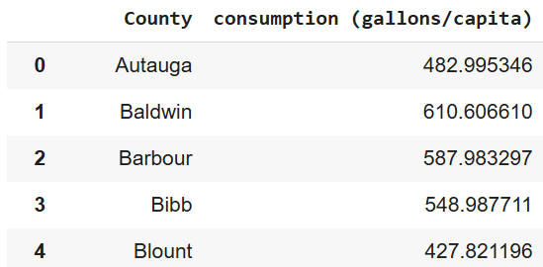
2030 Fuel Use Increase
Used regression to predict 2030 US fuel use
Divided 2016 fuel use by 2030 predicted use to get predicted percentage increase
Multiplied 2016 fuel use per capita by predicted percentage increase

Slide 13
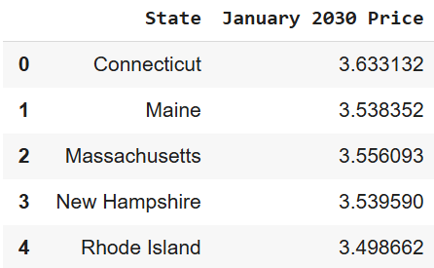
2030 Gas Prices by State
Ran a linear regression model for every state
Created a new dataframe with two columns: state and predicted 2030 gas price.

Slide 14
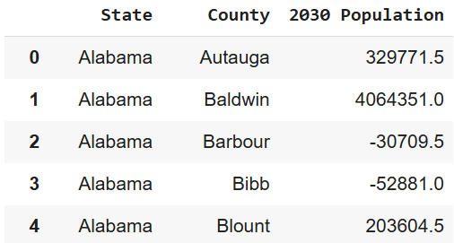
2030 County Population
Ran a linear regression for each county
Created a new dataframe.

Slide 15
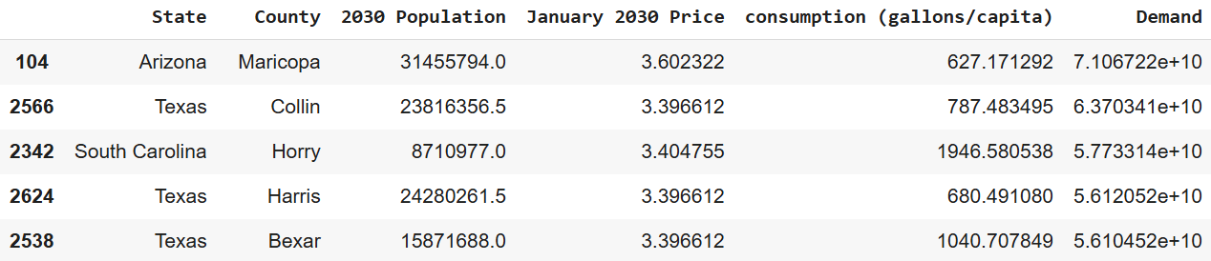
Data Merging
Merged datasets by county name
Multiplied (fuel use x population x gas price)
Stored in new column: “Demand”
Ordered “Demand” from highest to lowest

Slide 16
Conclusions
Notes:
Where to invest
Where to divest
Explore what is driving gasoline demand growth

Slide 17
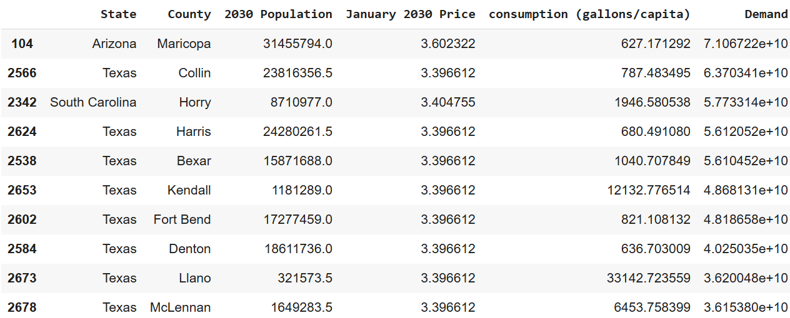
Results
14/20 top demand counties were in Texas
High consumption or population main determinants

Slide 18
Limitations
Data was available at different granularities
Old data
Linear regression is not necessarily ideal
Some populations were projected to be negative, which is impossible
Population alone is not a reliable determinant of demand
Howard, Texas
Notes:
Howard, Texas, is one of the largest exporters of oil, so investing in infrastructure to further support its efforts may be wise. However, this model predicts one of the lowest demands there.

Slide 19
Takeaways
It is wise to invest in gasoline infrastructure in counties with rapid population growth or high gasoline per capita use.
Especially Texas
However, determining where to invest involves taking a holistic view of all factors

Slide 20
Thank You!

